Slide 1
EE4820 Project Speech to Text.
By: Anthony Huynh &
Christopher Morales

Slide 2
Introduction
Gather a phoneme bank
  Use the spectrogram to gather the frequency and time range
  Gather characteristic of each phoneme
  Visually shows the active frequency of the phoneme
Gather information that can determine a speech file
  Uses the phoneme bank by determining the correlation of that specific window of the audio

Slide 3
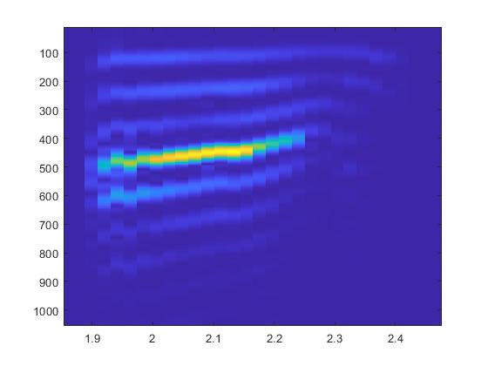
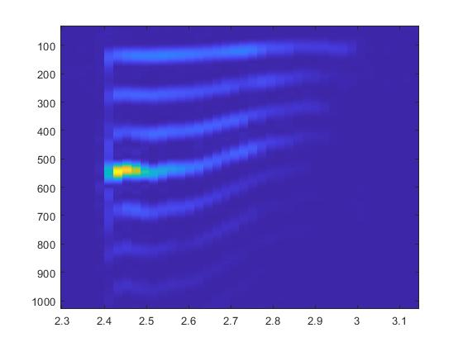
What was our thought process to approach this problem

Slide 4
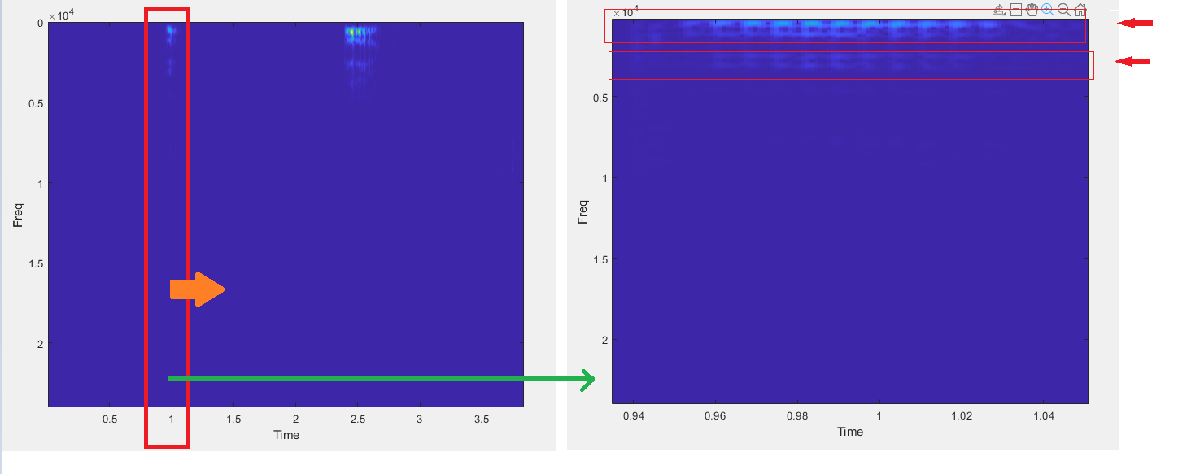
What was our thought process to approach this problem
Our thought process was to have a window shifting across the time domain, and somehow detect the different phonemes by checking each phoneme through some type of if statement. And then storing that phoneme. We would also have a way to check for repeating phonemes.
Notes:
Here you can see our thought process where we have a red window that would be moving across the time domain and we would have some stored data that would allow us to differentiate the phonemes.

Slide 5
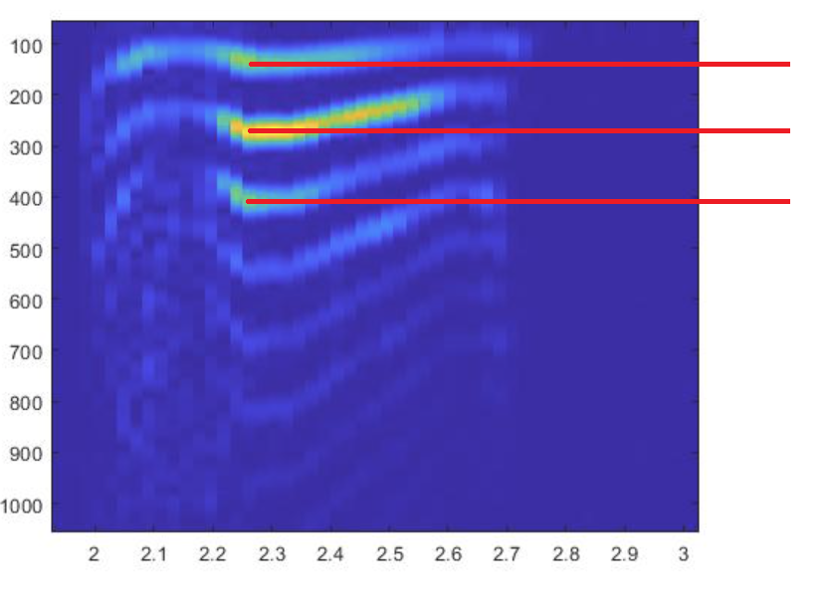
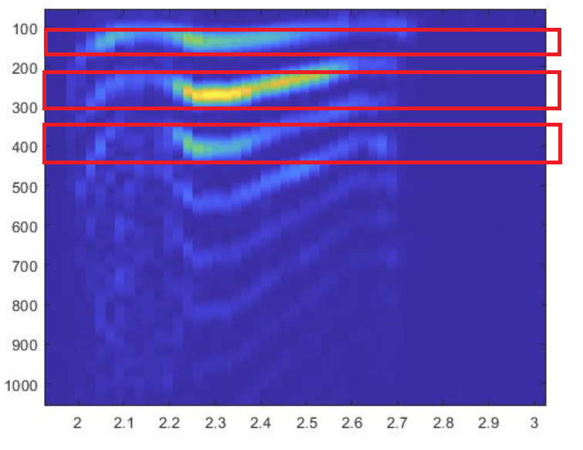
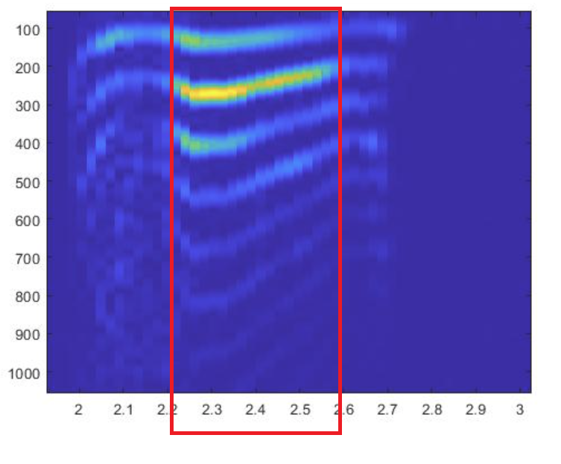
What methods we tried
Throughout this project we have tried 3 different methods, peak frequency, peak frequency bandwidths, and storing the whole frequency spectrum.
Method 1: peak frequencies
Method 2: peak frequency ranges
Method 3: entire frequency range
Notes:
Throughout this project we have tried 3 different methods, peak frequency, peak frequency bandwidths, and storing the whole frequency spectrum. Here we can see our 3 different approaches that we tried throughout the project. For method one you can see we selected the peak frequencies that we saw activity in and stored those densities as a threshold and used that to detect the phoneme. For method 2 we used a range of activity for each phoneme that we saw and we would store those frequency ranges and get an avg density in each range to use as a threshold. The final method that we used was the 3rd method where we would take the whole window segment of the active phoneme. We would then sum it across each frequency and get the avg for each frequency. Then we would be able to cross correlate this stored phoneme data with the current window we are detecting.

Slide 6
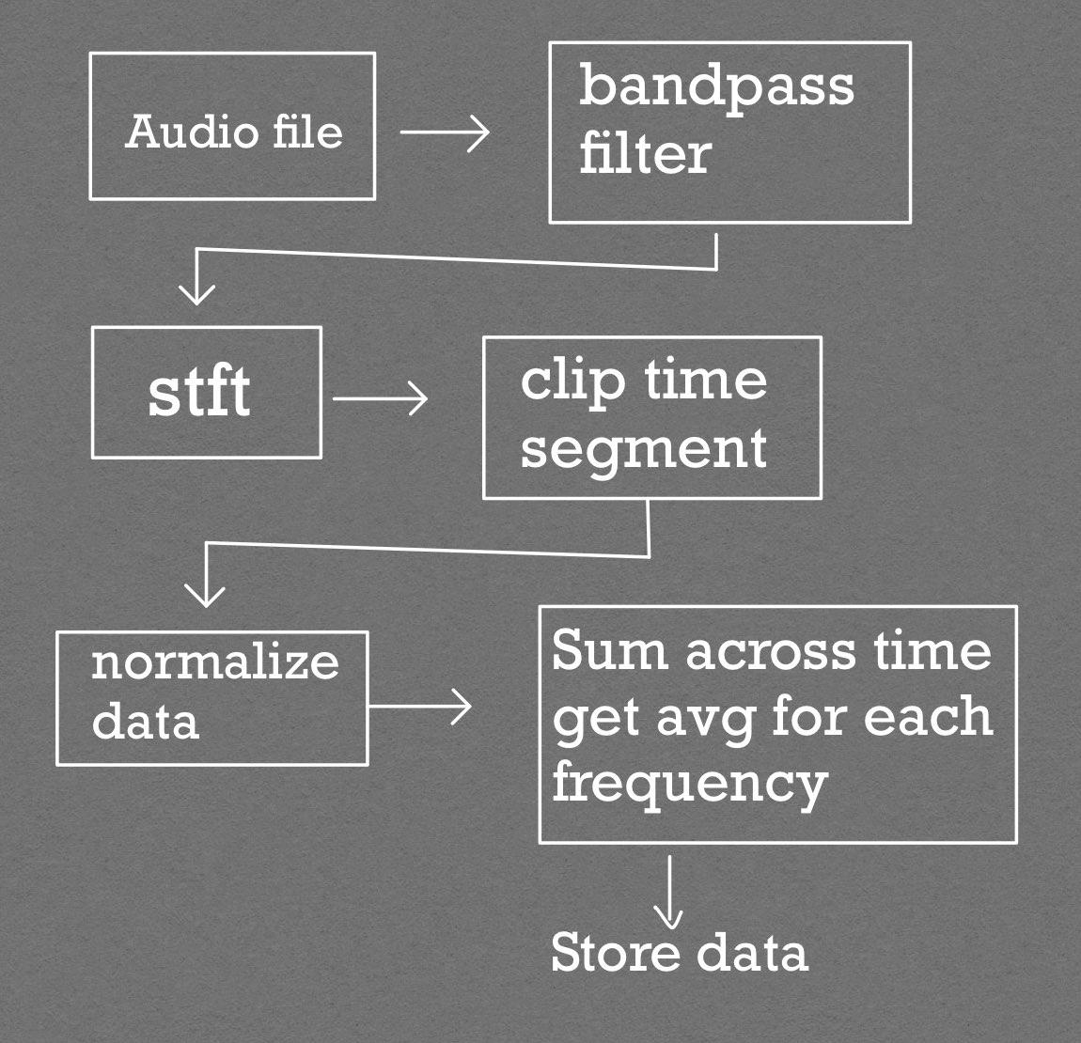
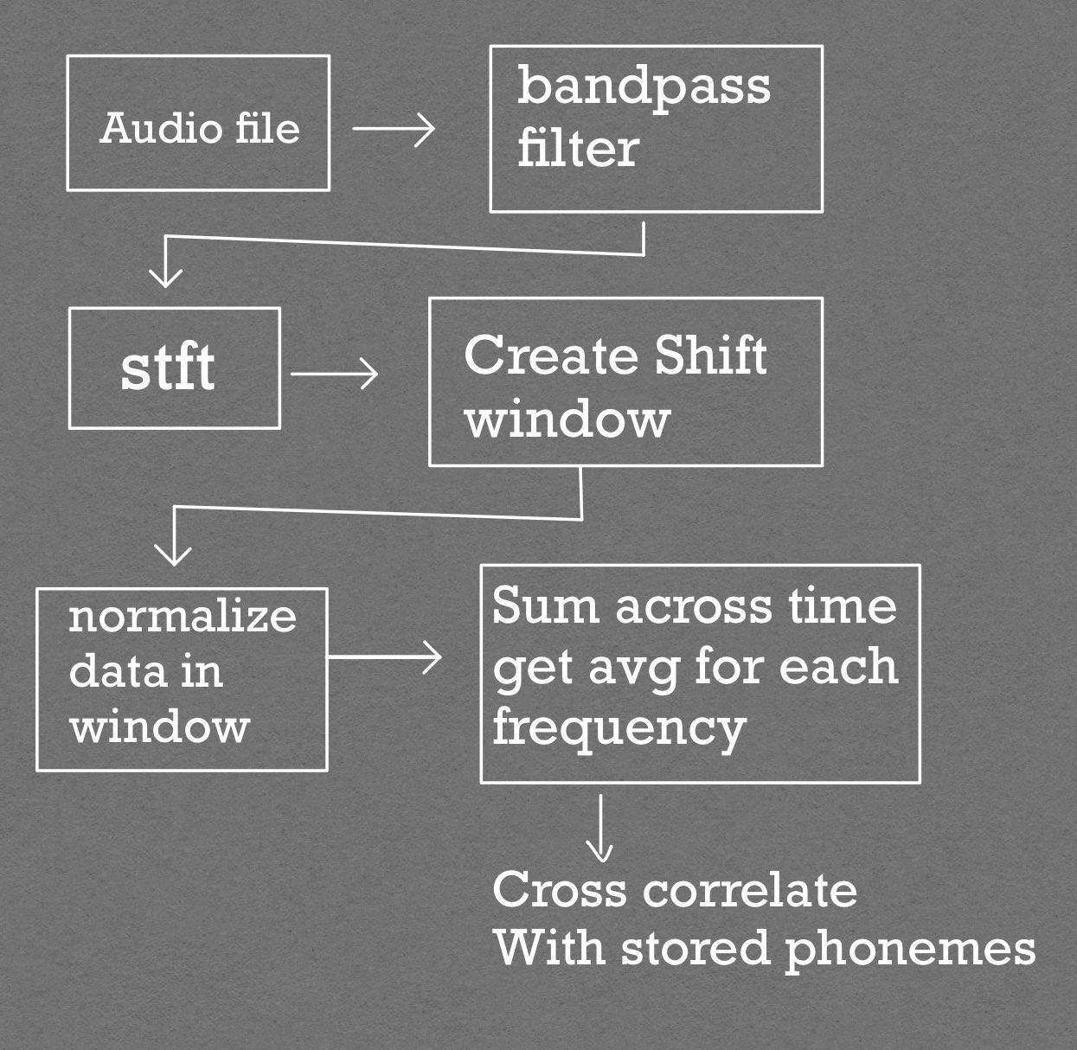
Method III Block Diagram

Slide 7
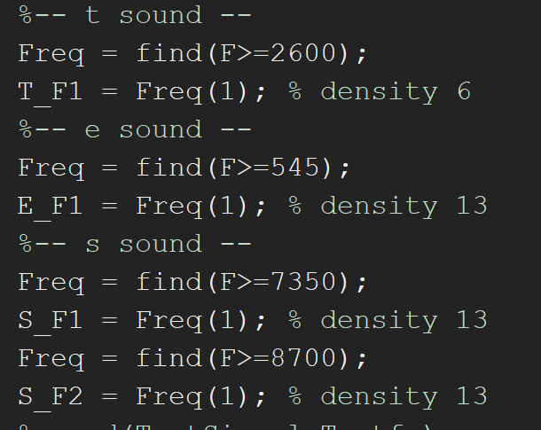
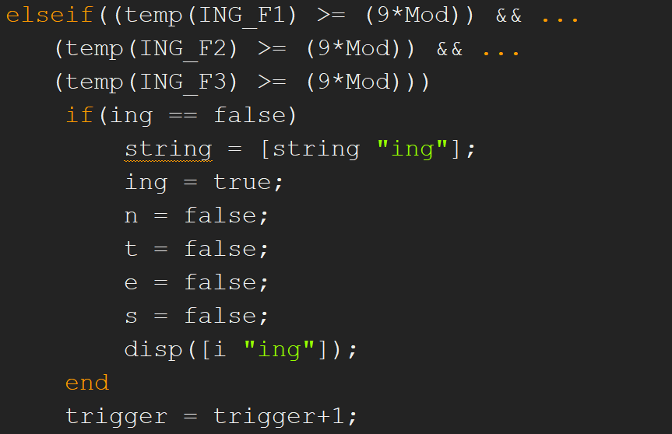
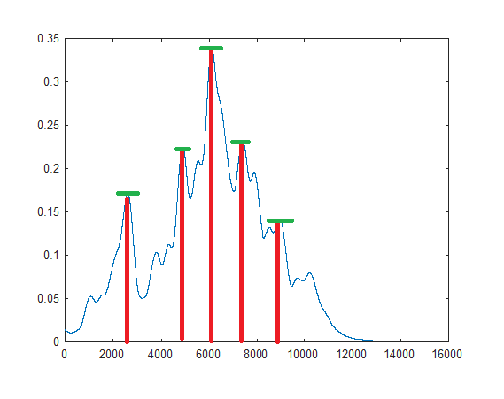
Method 1 extracting peak frequency or frequencies.
For our first method we would use the peak frequency and store that value with a threshold to be able to run an if statement to see if it the phoneme would trigger. If it did, then we would store that point in time as that phoneme.
Notes:
Here we can see that we store our peak frequencies and we keep in mind the peak density that it had as a threshold, if it passes the threshold then the if statement is triggered and the phoneme is recorded. Issues we had for this method was normalization where instead of normalizing the data. We tried to reduce the threshold by a percentage to allow some leeway of different dB of speaking.

Slide 8
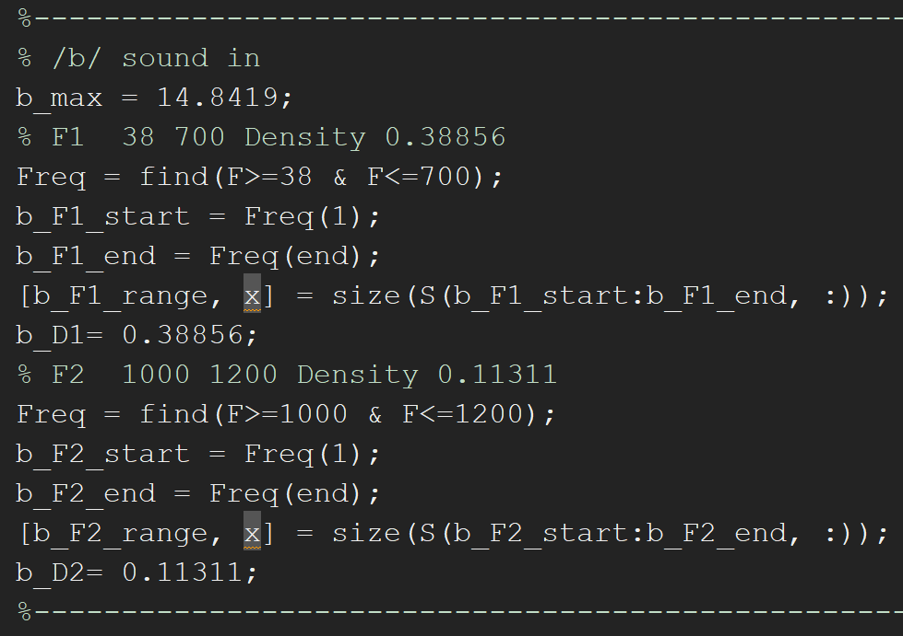
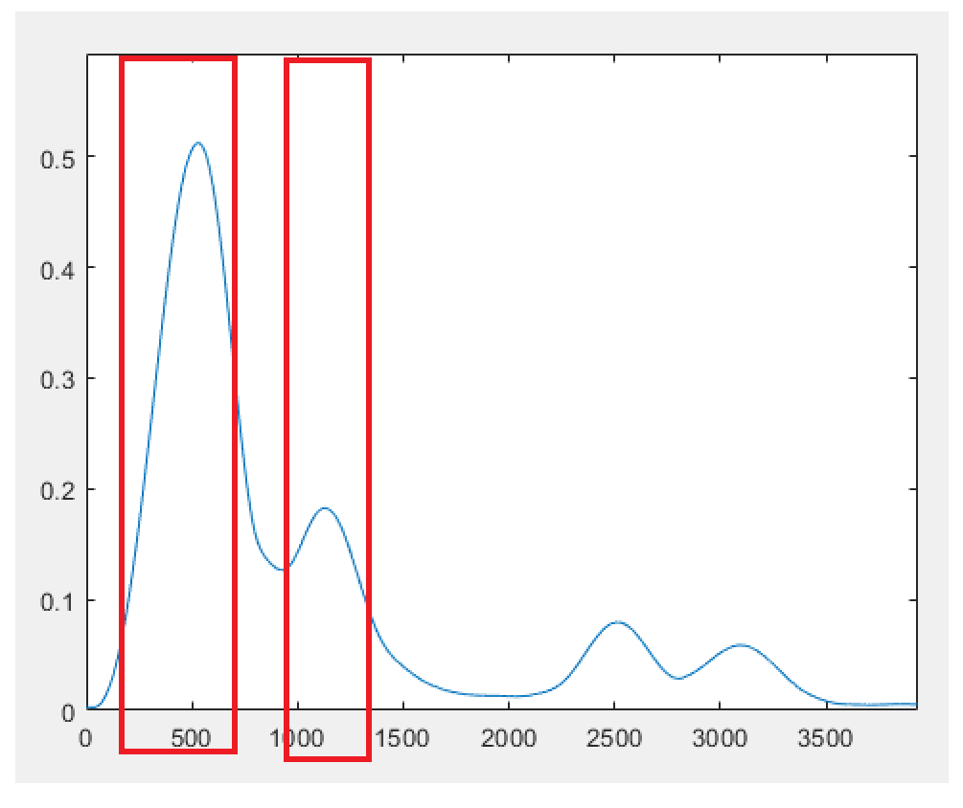
Method 2 using peak frequency ranges
Due to our issues with our first method for our second method we decided to store a range of the peak frequency and also store the avg density in that range. We also normalize the data by dividing the signal by its maximum density.
Notes:
Here you can see us storing the frequency range of 2 peak frequencies that we detected. We then got the avg density for each range and stored that as well to use as our threshold. When our threshold is triggered in our frequency range. We know that the signal is detected.

Slide 9
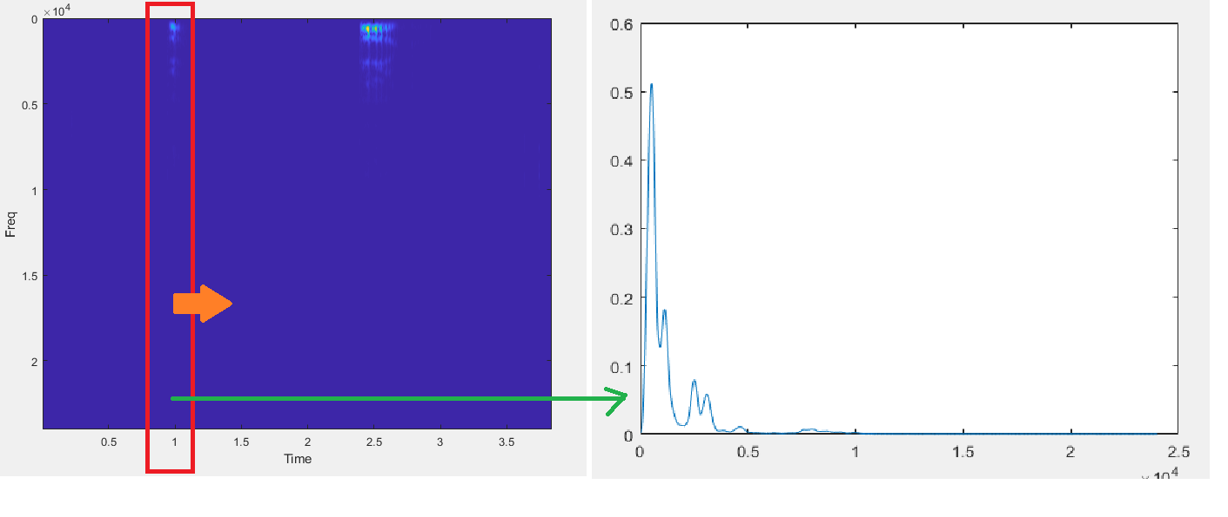
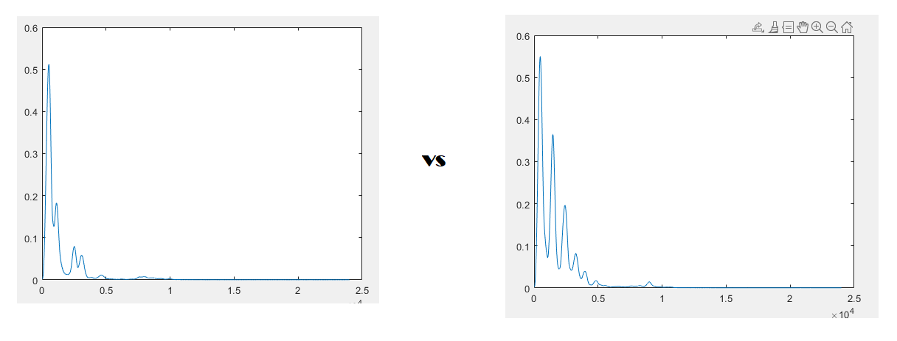
Method 3 corrcoef stored phoneme Frequency vectors and current window Frequency
Our final method that we settled on was storing the whole Frequency range of each phoneme so we can cross correlate it with the current window.

Slide 10
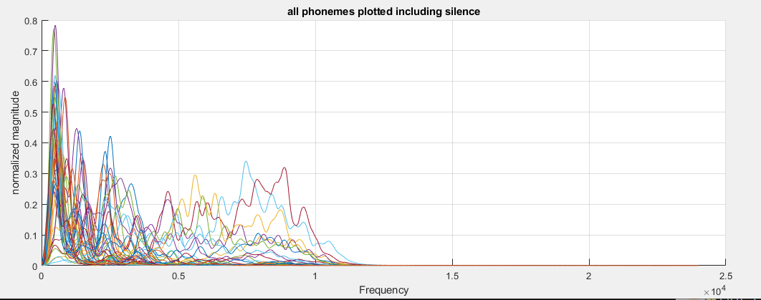
Method 3 corrcoef stored phoneme Frequency vectors and current window Frequency cont…
Notes:
All phonemes plotted

Slide 11
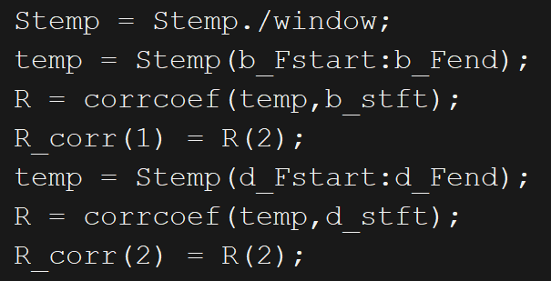
Method 3 corrcoef stored phoneme Frequency vectors and current window Frequency …

Slide 12
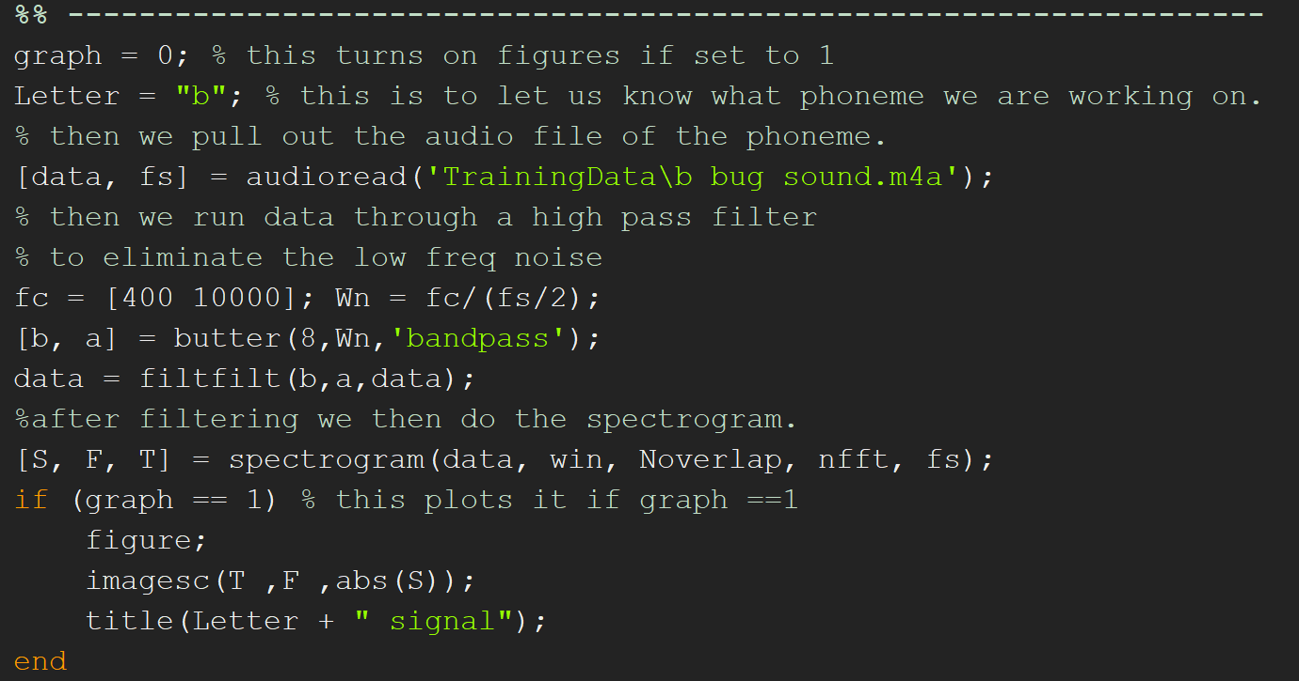
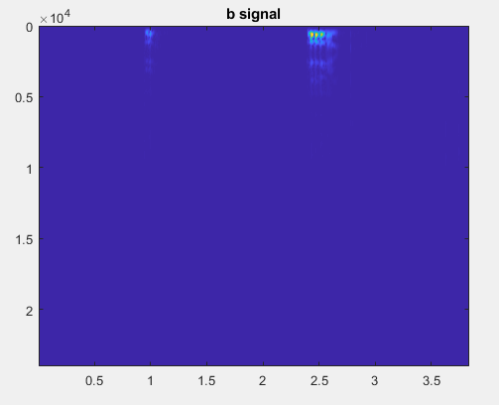
Results of our code/ how it works.
So the first step for our code is we run a separate code to gather all the phoneme data. To do this we have to load the audio file and find where the phoneme triggered in time domain

Slide 13
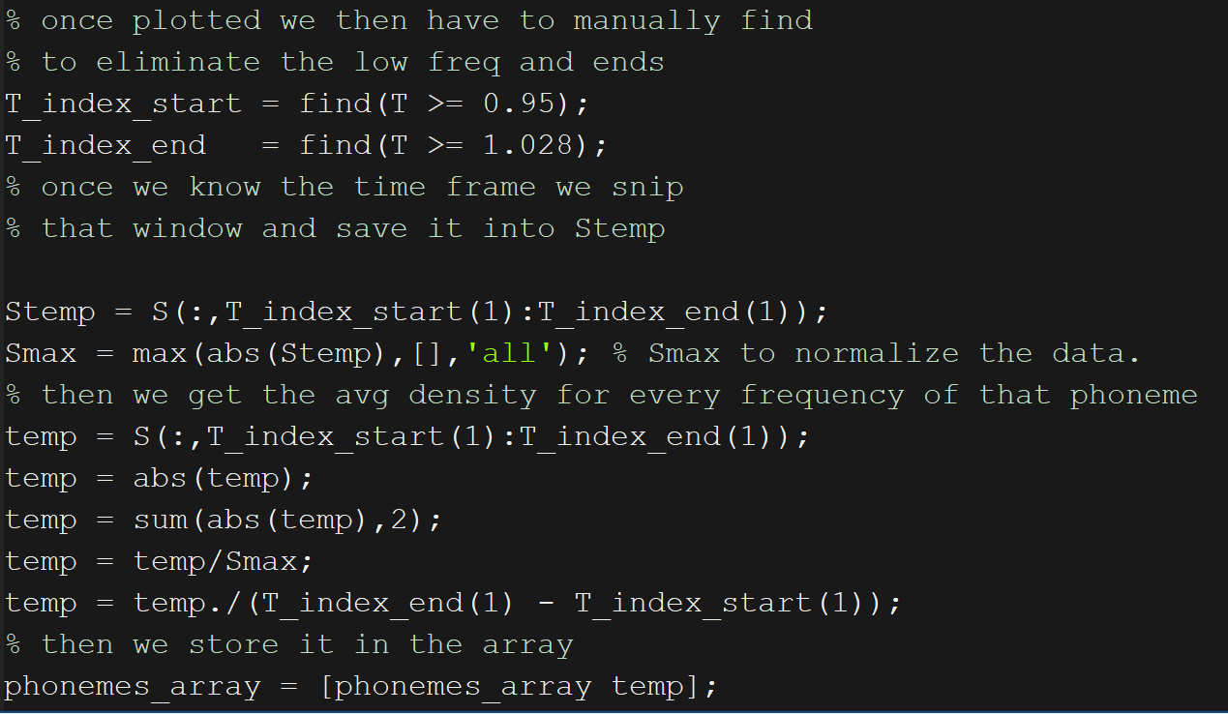
Results of our code/ how it works. cont…
Once we find the time start and end of the phoneme we save it and then snip that time window to save as Stemp.
We then normalize our Stemp by dividing by the max density found. We then sum up the values across each Frequency.

Slide 14
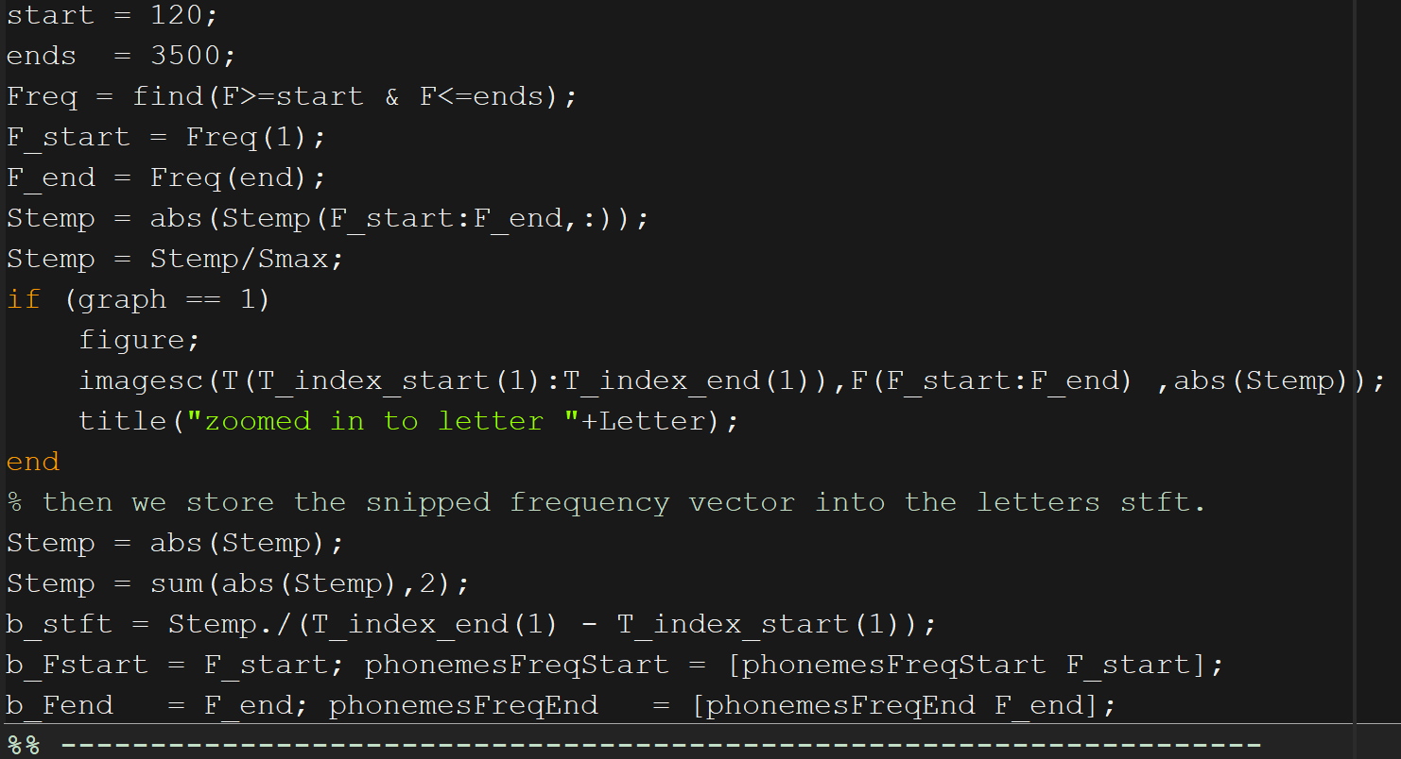
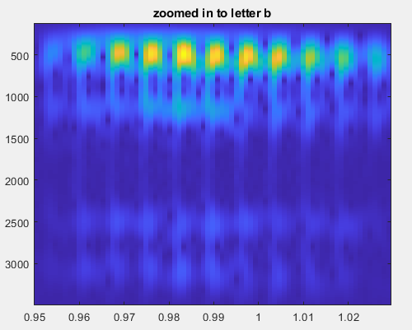
Results of our code/ how it works. cont…
Then as we talked about before we want to also narrow down the Frequency start and end to cut off where we see no activity.

Slide 15
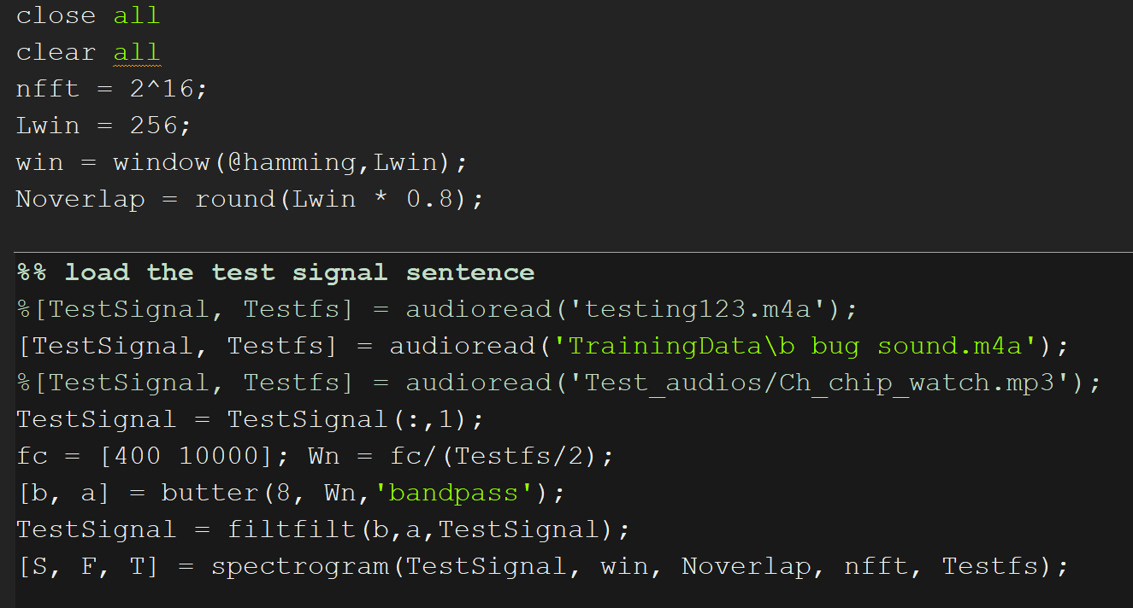
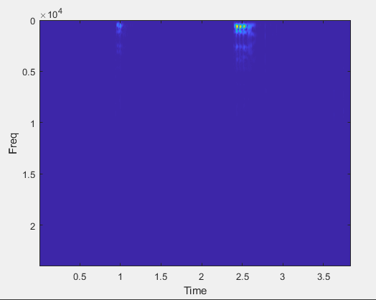
Results of our code/ how it works. cont…
Now we can go to our main code, first we load our signal and use a bandpass filter to eliminate low and high freq noise. Then we do the Stft and plot the Time vs Freq.

Slide 16
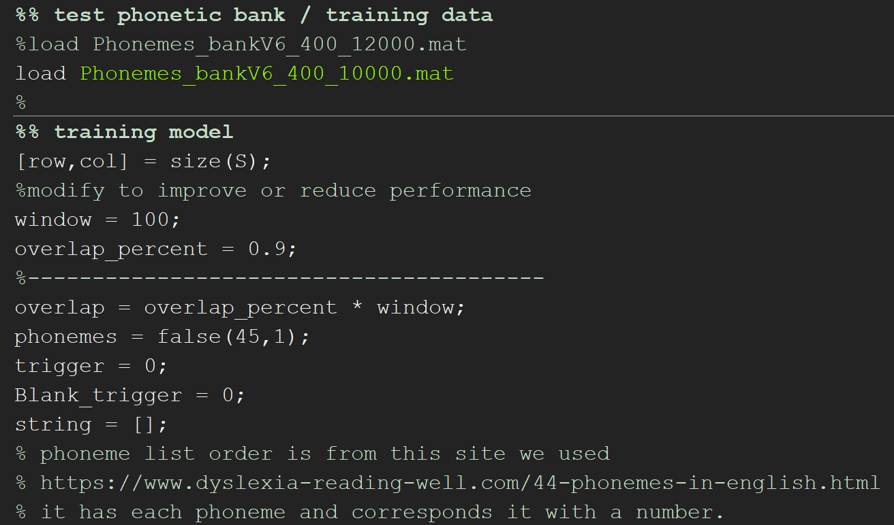
Results of our code/ how it works. cont…
Next we would load our phoneme bank and set the parameters for our window. Such as how big the window is and how much overlap would we want.
The Pros and cons of increasing and decreasing the window size is if we have too big of a window, we could miss some of the phonemes due to the avg diluting the frequency. However if our window is too small, then we see much more false positives due to small sample size.

Slide 17
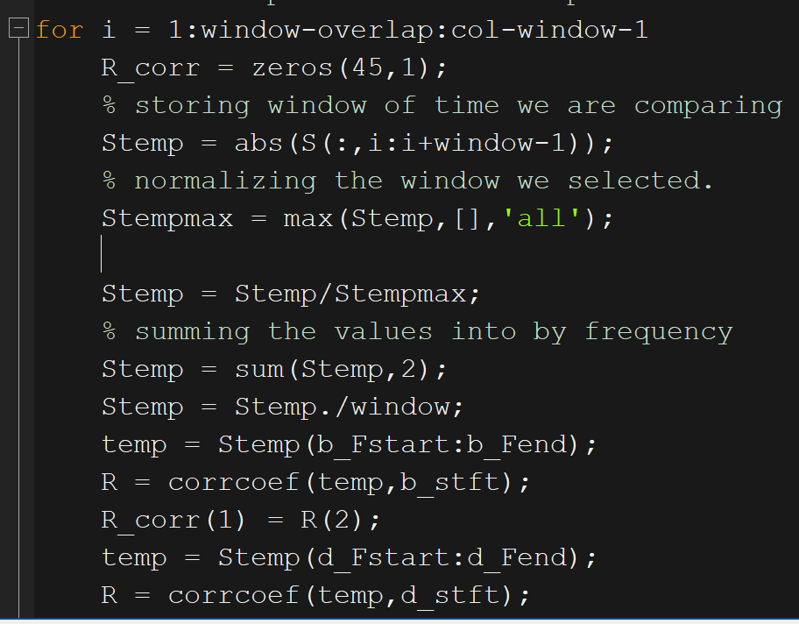
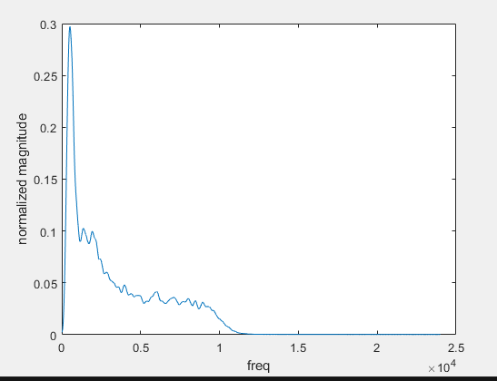
Results of our code/ how it works. cont…
Once we step into our for loop which would be shifting our window across our time domain, we store our temporary window values into Stemp.

Slide 18
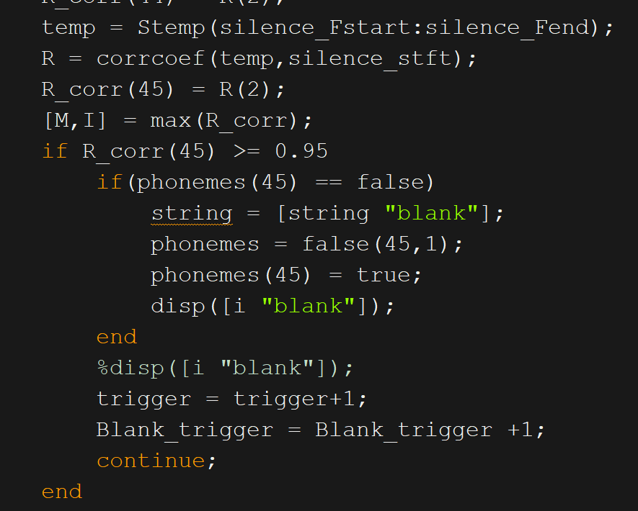
Results of our code/ how it works. cont…
Once we correlate all the phonemes with the window we select the highest correlation and that would be our current phoneme.
We had an issue with false triggers of phonemes, so to prevent this we had an if statement before the phonemes for silence where if the threshold of 95% correlation was triggered then it would see that cycle as silence and skip the other if statements.

Slide 19
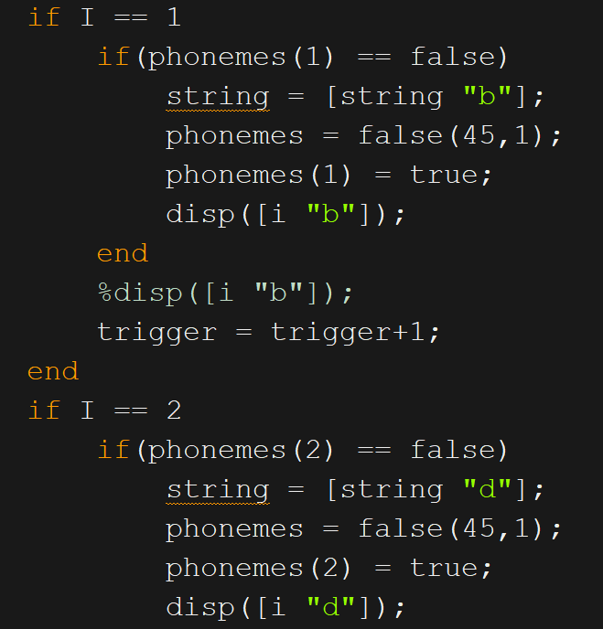
Results of our code/ how it works. cont…
If silence was not triggered then we would choose the phonemes regularly where our max correlation index would correspond to a phoneme.

Slide 20
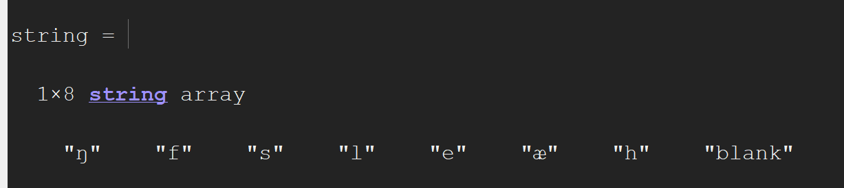
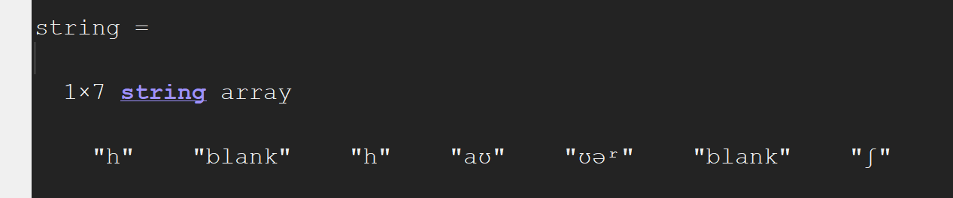
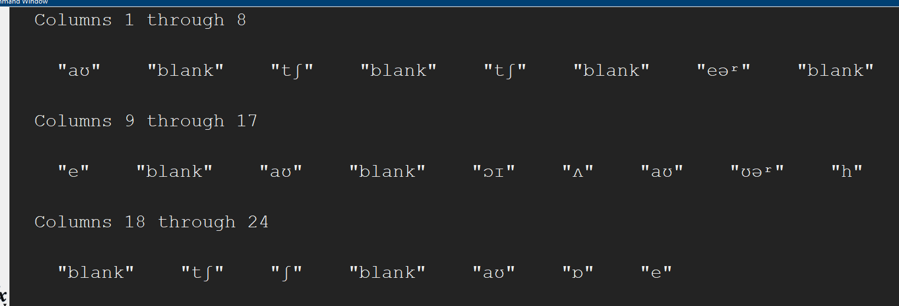
Output of the code:
/f/ fat sound
/h/ hop sound
/ch/ chip watch

Slide 21
What issues did we have
Some issues in the end that we had was detection of a phoneme when there wasn't any audio detected.
Another issue we had was false triggers of different phonemes in between where the correct phoneme is

Slide 22
What things can we improve.
We noticed that some of the issues we have can be due to the quality that our audio was recorded on. To improve this we would need to get a better mic or have less background noise when recording.
Another issue can be our enunciation of the phoneme might not be as good. We noticed this for when we pronounced the oo in book and the oo in too. While they were different phonemes. Our pronunciation of the word in the stft domain looked similar.
We also noticed that since we had background noise we tried to filter it out using a band pass filter but it seemed to still allow background noise through.
Another improvement could to also mess with the window sizes of the window shifting, and the window of the stft to further optimize it.

Slide 23
Thank you!
Q&A

